Slide 1
PIXEL IOAI SOLUTION
code by Shokhjahon Isroilov
presentation by Sergo Tovmasyan

Slide 2
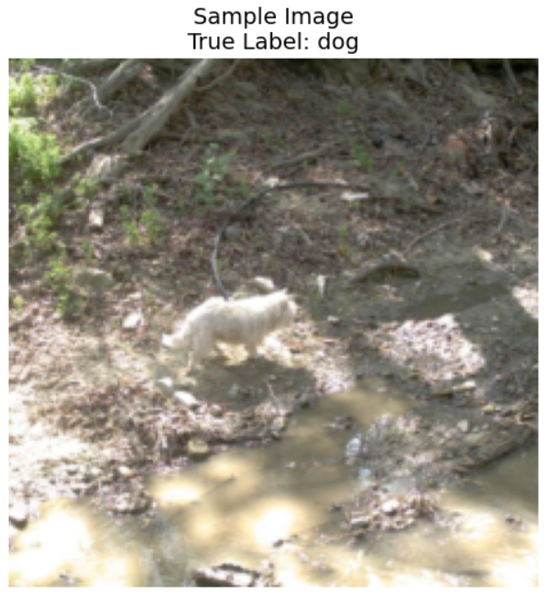
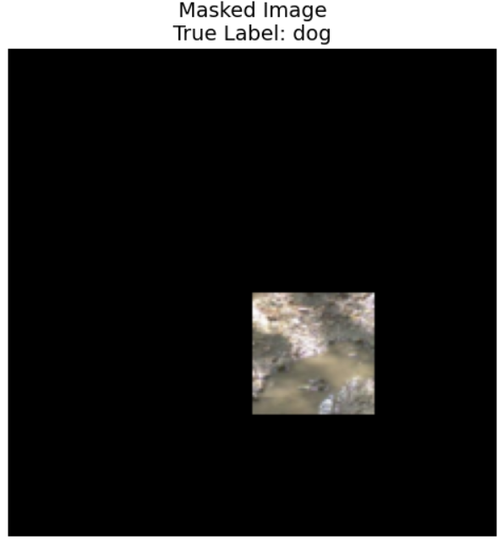
The Task

Slide 3
Main idea of solution
we wanna get the best tuple of coordinates
to find those cooridnates we need to find the part of image that contaies the most usefull information for true classification
to find the best “window” we check 16 different tuple of coordinates
for each tuple(coordinates) we calculate 2 metrics → distance from centere and variance
the best part is the one, who’s variance value is big and who’s distance from center is small
now we need to check, does model give us the same class for best part, if yes -> cool, we found it, if no → that means that the most informativ part is the center of image

Slide 4

main functions
spatial_priority
calculate the distance between center of coords and returns the distance * (-1)
tile_varience
calculates the variance of croped image, returns variance
generate_crop_coordinates
sliding window to cretae list of croped images coordinates, then calculates spatial_priority and tile_variance for each and sort elements by them(from high to low) then takes every element from that list and get predicted label, if predicted label is equal to true label, returns coordinates of the crop, if there is no such a crop, returns coordinates of center

Slide 5
Spatial priority and varience
sorting the list of coordinates
how it works
01
02
if special priority value is high -> croped part is close to center, and if variance is high, that means → posibility that animal is there is high
we wanna find best part as soon as possible, for this we must sort our list of coordinates, if var is high and spatial priority is high → than it is probably the best crop, and we need to take him first
prediction and true label
03
what if there is no good crop?
04
now we take elements of list and get their true labels, and take clip prediction for this crop → if they are equal that is it, if not → we try another element
if there is no such a crop that has the same label as original, our code takes center crop

Slide 6
Adventages
01
03
we dont do clip fine tuning, attention rollout or other thinks that takes long time from us
code takes about 7 minute for sumbission.json creation
02
04
Solution is simple and gives a good results
Training → 76%
Test → 80%
This solution without “AI” part gives us better results than with “AI techniques”, so its just a programing, and it will work everywhere

